Slide 1
WEB DEVELOPMENT · LECTURE 1
Internet Networks
and Web Requests
IN THIS PART
How networks connect
Who operates them
IP, MAC, routers
DNS and URL parts
HTTP, HTTPS and TLS
Part 2
Follow the path from your device to a website—and back again.
Designed as the continuation of Lecture 1 · Part 1
Notes:
Introduce this as a continuation of Part 1. Students will trace one web request using a few essential networking ideas.

Slide 2
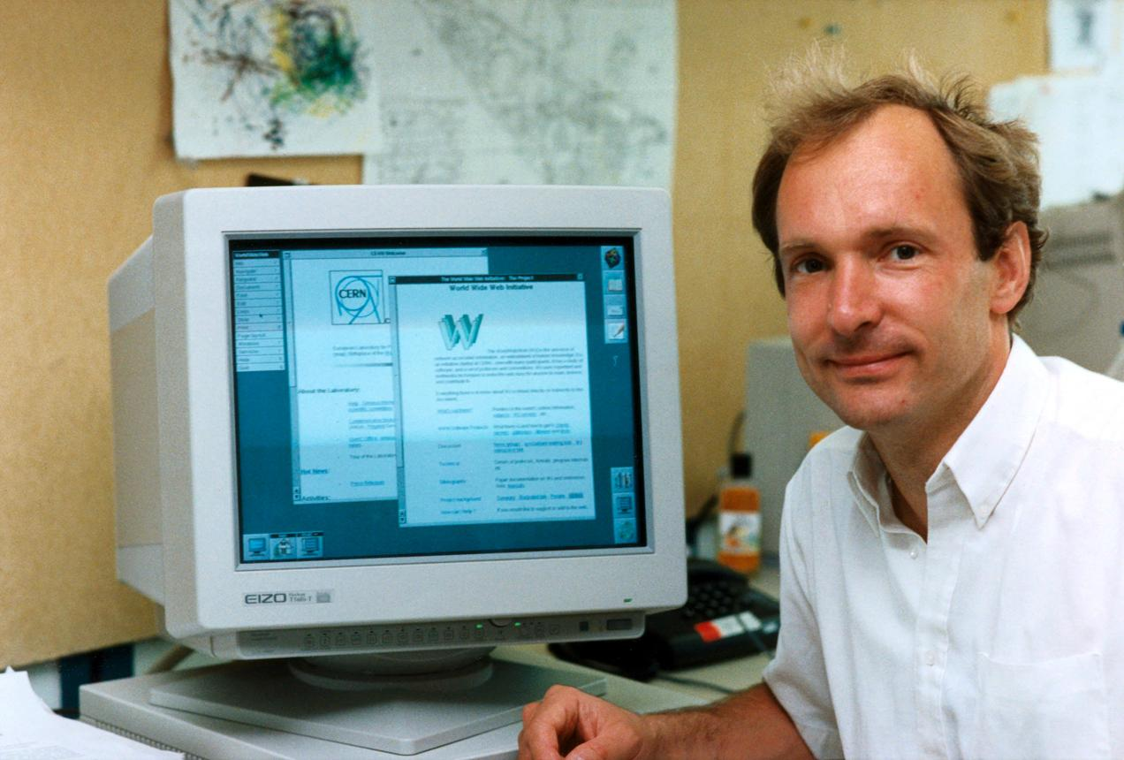
LECTURE 1 · PART 2
The Internet grew as networks connected
1969
ARPANET connects its first four computers
1970s
Researchers develop TCP/IP
1983
ARPANET adopts TCP/IP
1986
NSF begins NSFNET
The Web is one service built on the Internet.
1989
Tim Berners-Lee proposes the Web
INTERNET NETWORKS AND WEB REQUESTS
02
Notes:
Internet Society history: https://www.internetsociety.org/internet/history-internet/brief-history-internet-related-networks/
The image of Tim Berners-Lee is supplied in the lesson folder. Explain that the Web came later than the underlying Internet.

Slide 3
LECTURE 1 · PART 2
The Internet is a network of networks
A university connects its own devices first. Its local network can then connect to regional and larger networks.
UNIVERSITY A
REGIONAL NETWORK
BACKBONE
UNIVERSITY B
→
→
→
Computers · server · LAN
Connects local networks
Carries traffic across regions
Computers · server · LAN
Shared protocols let separate networks exchange data.
A backbone is like a major highway joining many regional roads.
INTERNET NETWORKS AND WEB REQUESTS
03
Notes:
Use the road analogy only to explain scale. TCP/IP provides common rules across networks. Internet Society history: https://www.internetsociety.org/internet/history-internet/brief-history-internet-related-networks/

Slide 4
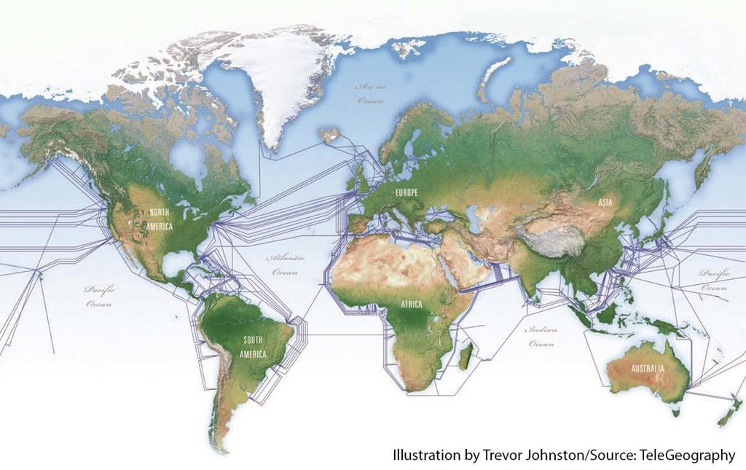
LECTURE 1 · PART 2
Physical links carry data between places
Networks connect through infrastructure such as:
Fiber-optic cables
Across cities and under oceans
Telecom networks
Local and long-distance links
Data centers
Buildings that house servers
Satellite links
Useful in some locations
Many organizations build and operate different parts of this infrastructure.
INTERNET NETWORKS AND WEB REQUESTS
04
Notes:
The map is supplied by the instructor. It illustrates submarine cable routes; it is not a complete or real-time map of all Internet links.

Slide 5
LECTURE 1 · PART 2
ISPs connect their networks
An ISP provides Internet access to homes and organizations, then connects to other networks.
YOUR DEVICE
YOUR ISP
IXP / PEERING
OTHER ISP
WEBSITE
→
→
→
→
Home Wi-Fi
Internet access
Traffic exchange
Another network
Server
Peering
Transit
IXP
Networks agree to exchange traffic directly.
One network pays another to carry traffic to more destinations.
A place where networks connect and exchange traffic.
INTERNET NETWORKS AND WEB REQUESTS
05
Notes:
Keep peering, transit and Internet Exchange Point (IXP) at a high level. A diagram is simplified: actual routes can cross several networks.

Slide 6
LECTURE 1 · PART 2
No single organization owns the whole Internet
Organizations operate different networks and coordinate selected technical functions.
ICANN
Coordinates the global DNS and unique Internet identifiers
IETF
Develops voluntary Internet protocols and technical standards
ISOC
Supports an open, globally accessible Internet
APNIC
Manages Internet number resources for Asia Pacific
Many operators. Shared standards. Interconnected networks.
INTERNET NETWORKS AND WEB REQUESTS
06
Notes:
No single owner controls the entire Internet. ICANN: https://atlarge.icann.org/about/what-does-icann-do
IETF: https://www.ietf.org/about/introduction/
APNIC: https://www.apnic.net/about-apnic/organization/
The Internet Society supports open Internet development and access: https://www.internetsociety.org/

Slide 7
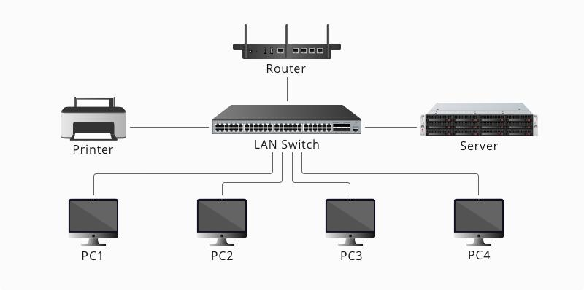
LECTURE 1 · PART 2
Router, switch and Wi-Fi have different jobs
SWITCH
Connects devices inside a local network
ROUTER
Forwards traffic between different IP networks
WI-FI
Wireless technology that connects devices to a network
Home routers often combine several functions in one device.
INTERNET NETWORKS AND WEB REQUESTS
07
Notes:
The supplied LAN image distinguishes a router and switch. Many home devices combine router, switch and Wi-Fi access point functions; clarify that Wi-Fi is not the router itself.

Slide 8
LECTURE 1 · PART 2
IP and MAC addresses work at different levels
IP ADDRESS
MAC ADDRESS
Helps identify a source and destination across IP networks.
Helps identify a network interface on a local link.
Think: the address on a parcel.
Think: local delivery within the building.
When data moves through multiple networks, the IP destination remains important; local-link delivery uses MAC addresses.
INTERNET NETWORKS AND WEB REQUESTS
08
Notes:
Use the parcel analogy carefully: addresses are not exactly equivalent. A MAC address is a link-layer address associated with a network interface and is used for local-link delivery.

Slide 9
LECTURE 1 · PART 2
DNS looks up the address for a domain
People use names. Networks use IP addresses to route traffic.
DOMAIN
DNS RESOLVER
IP ADDRESS
google.com
→
Looks up the name
→
Destination address
DNS is like a contacts list: a name helps you find the number.
DNS helps find an address. It does not host the website.
INTERNET NETWORKS AND WEB REQUESTS
09
Notes:
DNS stands for Domain Name System. A recursive resolver may be provided by an ISP or another DNS service. DNS resolves names; it does not store or host website pages.

Slide 10
LECTURE 1 · PART 2
A URL has parts that tell the browser what to request
Example URL
https://www.google.com/search
SCHEME
HOST / DOMAIN
PATH
https://
www.google.com
/search
How to connect
Which host to reach
Which resource or route
URL = Uniform Resource Locator
INTERNET NETWORKS AND WEB REQUESTS
10
Notes:
A URL can contain additional components such as query parameters and fragments. This first example focuses on scheme, host and path.

Slide 11
LECTURE 1 · PART 2
What happens after you enter a URL?
1
Browser reads the URL
Identifies scheme, host and path
2
DNS resolves the host
Finds an IP address for the domain
3
Device sends traffic
Uses local network, router and ISP
4
Server receives a request
HTTP defines the web request
5
Server sends a response
Browser receives content and displays it
INTERNET NETWORKS AND WEB REQUESTS
11
Notes:
This is a simplified sequence. DNS resolution and connection setup can happen through cached or reused results/connections. Avoid suggesting every resource uses a brand-new connection.

Slide 12
LECTURE 1 · PART 2
HTTP request and response
REQUEST · BROWSER → SERVER
RESPONSE · SERVER → BROWSER
GET /search
Host: www.example.com
“Please send the search page.”
HTTP/1.1 200 OK
Content-Type: text/html
[Page content]
Status codes summarize the result: 200 = success · 404 = not found · 500 = server error
INTERNET NETWORKS AND WEB REQUESTS
12
Notes:
The examples are simplified. HTTP is a request-response protocol used by browsers and servers. Status codes describe the outcome; 200 is a successful response, 404 indicates a resource was not found, and 500 indicates a server error.

Slide 13
LECTURE 1 · PART 2
HTTPS protects the connection with TLS
HTTP
HTTPS
Rules for browser–server communication.
HTTP over a connection protected by TLS encryption.
TLS helps protect data while it travels between browser and server.
HTTPS is useful, but it does not by itself prove a website is honest.
INTERNET NETWORKS AND WEB REQUESTS
13
Notes:
TLS stands for Transport Layer Security. HTTPS uses TLS to protect the connection in transit. It does not guarantee that a website is trustworthy or that its content is safe.

Slide 14
LECTURE 1 · PART 2
One visit brings the concepts together
YOUR DEVICE
ROUTER
ISP / NETWORKS
DNS
WEB SERVER
→
→
→
→
Browser + local IP
Forwards traffic
Carry traffic onward
Finds the host IP
Returns a response
Request: browser → server
Response: server → browser
The browser renders the returned HTML and requests other page resources as needed.
INTERNET NETWORKS AND WEB REQUESTS
14
Notes:
This diagram intentionally simplifies DNS and routing. DNS is a lookup service used to resolve a host name; it is not necessarily a network hop in the same data path as the web server request.

Slide 15
LECTURE 1 · PART 2
Check your understanding · Networks
01
How did separate university networks become connected?
02
What is the difference between an IP and a MAC address?
03
What does a router do? How is a switch different?
04
What is peering? What is an Internet Exchange Point?
05
Does one company own the whole Internet?
INTERNET NETWORKS AND WEB REQUESTS
15
Notes:
Give students time to answer in their own words. Emphasize the network-of-networks idea and distinguish switch, router and Wi-Fi.

Slide 16
LECTURE 1 · PART 2
Check your understanding · Web requests
06
Why does a browser use DNS? Does DNS host website pages?
07
Which parts of a URL are the scheme, host and path?
08
What is the difference between an HTTP request and response?
09
What does HTTPS add? What is TLS?
10
What does an HTTP status code tell us?
Next: begin HTML in more detail
INTERNET NETWORKS AND WEB REQUESTS
16
Notes:
Use these questions to check the main concepts. Next lesson: HTML structure and core HTML elements.

